Slide 1

Events Management: Principles & Practice, 4th Edition
By Razaq Raj and Tahir Rashid

Slide 2
Chapter 20
Sport Events
These are some bullet points:
The world of sport events has changed over the last two decades with major sporting events being moved around the globe.
The sport events has very close relationship between different stakeholders on the economic, political and marketing perspectives.
The Covid-19 impact on the sporting industry has been significant with numerous challenges faced by different stakeholders.

Slide 3
Sports Events Perspective
Various terms have been used to define sporting events and festivals such as mega-event, hallmark event, major sporting events and special events and these terms have been used interchangeably.
These terms depends on different combination of size, geography, economic return, length of event and the identification to location.
The sport events represents a variety of sports and therefore not one single type of event has an influence on the industry.

Slide 4
The Life Cycle of Sports Event
Parent and Smith-Swan (2017) outlined three stages of life cycle of a major international sports event:
  The first stage is planning and starts with the bid phase which normally last between one to three years depending on the type of event.
  The second stage consist mainly of the implementation plan.
  The final stage is concerned with closing ceremonies and a wrap up of the event.

Slide 5
Guide for Sport event Managers
Planning (1-6 years)
Bid
(1-3 years)
Implementation (3 Years)
Wrap Up
(6-12 months)
Transition
(6-8 months)

Slide 6
Mega Sports Events
Mega sporting events are large scale sports competition which have significant international interest in a short period of time.
Examples of such events include World Cups and Olympic Games and to host these events countries have to meet specific criteria besides just having necessary support facilities and adequate infrastructure in place.

Slide 7
Economic Perspective Of Sports Events
Sports events can enable substantial short-term and long-term economic benefits to the hosting region and usually attract intense competition.
In the short-term this could be through attracting visitor spending, the promotion of the host city; and in the long-term, by enhancing the region’s image as a sport tourism destination.
Staging sports events incurs upfront operational expenditure through, for example, investments, staff salaries, marketing, facilities, and equipment.

Slide 8
Case Study Measuring the Economic Impact of Events on Host Cities.
Figures released by Longwoods International
$31 billion was spent in the United States by travellers who spent at least one night attending or participating in a sporting event in 2017.
120 million trips were made last year to sporting events.
People spent $256 per person various activities including hospitality, transportation, food and beverage, retail and recreation.
$11.4 billion was spent directly by visitors at sports events in the U.S. in 2017

Slide 9
Long-term Legacy of Events
The International Olympic Committee in (2017) stated
  “Olympic legacy is the result of a vision. It encompasses all the tangible and intangible long-term benefits initiated or accelerated by the hosting of the Olympic Games/sport events for people, cities/territories and the Olympic Movement.”

Slide 10
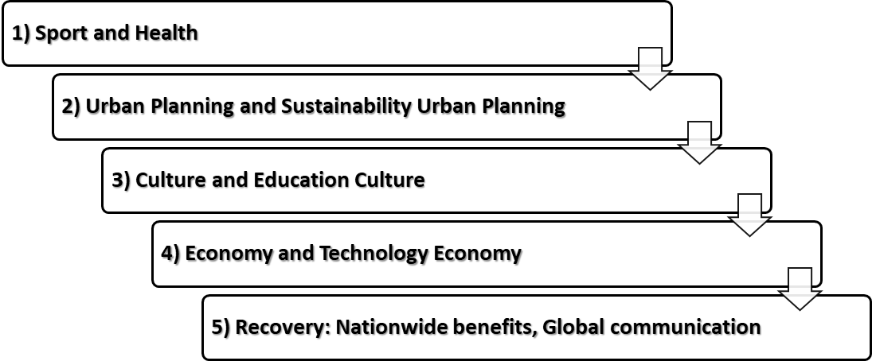
Tokyo 2020 Action and Legacy Plan
Tokyo 2020 Five Pillars Legacy Action Plan

Slide 11
Types of Legacy
Legacy
Sporting | The introduction of a variety of sports within the area Increased participation of women in the Olympic Games improves the percentage of females actively involved in sports activities in the host community World class sporting facilities
Political | Potential for improvement in education Promote the Olympic Truce as a cultural aid Introduction of various cultural considerations to t-he host community
Economic | Difficult to measure due to constant variables Long-term benefits for the community through regeneration projects
Social | Builds upon national pride and traditions Long-term recognition as a successful sporting nation Used as an historical tool, educating the young community about its social past

Slide 12
Economic Impacts of Events
Economic impact reports suggests that mega events can bring a significant economic value to a host community, whether through tourism or major infrastructural build programmes.
The spending is reported as providing significant and worthwhile additions to the host locations.
In most circumstances that infrastructure in the shape of homes, roads and commercial buildings is a welcome addition to any city.

Slide 13
Economic Impacts of Events
Ki Wan and Song (2019) provides comprehensive view on hosting mega-events.
“However, the cost of infrastructure investments and promotion may outweigh the benefits generated by the mega-events. Measuring the impact of such events on a hosting country’s economy is not easy, especially as mega-events generally involve many sectors of a destination’s economy.”

Slide 14
The Economic Legacy of the Rio Olympic Games
The Rio Olympic Games cost at least US$13 billion: 58.52 per cent was financed privately and 41.48 per cent by public funds.
The estimated budget in 2009 when Rio was US$9 billion
The preparation for such an event would allow Brazil to create 120,000 jobs by 2016.
Olympic Village, which comprised 31 residential buildings with 3,604 apartments for housing athletes (after the event they were sold); and the City of Rock, a recreation park for the athletes during the Games.

Slide 15
Economic Challenges for Olympic Games
The Tokyo Olympics (2021) are facing similar problems us previous games.
Due to Covid-19 postponed of the games, it has increased the budget by 22 precent for organising committee and will cost $15.4 billion to stage the games in 2021.
This has added extra cost of $2.8 billion to operational budget of the games due to one-year delay.
This increase has been incurred due renegotiating contracts and putting extra measure to safeguard people attending the games from Covid-19 pandemic.

Slide 16
Environmental and Social Impacts of Events
Event organisers are now using historical and cultural themes to develop annual events that attract visitors and create cultural images in the host cities by holding festivals within community settings.
Many event organisers do not take into account the social and environmental impacts.
The impacts of events can greatly affect the quality of life of the local residents.
It is important for event managers to address the concerns of the local people and reduce the negative impacts.

Slide 17
Urban Regeneration of Cities Through Mega Events
Within western democratic nations bidding for mega events is driven in the main by a policy known as ‘urban regeneration’, a product of urban neglect in many metropolitan cities.
Coupled with that programme of redevelopment we also have social impact, a major addition included within bidding documents for mega events.
The London 2012 Games were located on contaminated and derelict land untouched since the Second World War.
The event had a social, environmental and economic reach over five boroughs in London.

Slide 18
Case study Brazil World Cup
$350 million hole is biggest Brazil World Cup legacy for host
Standards are developed by the industry representatives and academics at international scale.
Event organisers need to use ISO 20121, because it offers number of benefits to key stakeholders within events industry.

Slide 19
Summary
Spending by visitors on local goods and services has a direct economic impact on local businesses and passes the benefits to local community.
Substantial attention is still being paid by governments and the events industry to the economic dimensions of impacts.
The event organiser and local government only take into account the economic impacts and ignore the implications of social impacts of the events.
Long-term financial projections should pay attention to the financial data that gives an accurate fiscal spend.

